Slide 1


Automatic Solar Lighting System Atahan Bakanyildiz, Romi Gilat, Cedar Maxwell, Nick Miller

Slide 2
What is the Automatic Solar Lighting System?
Problem: With increasing grid demand and reliability issues, integrating solar energy into homes is vital. Solar power offers a dependable, independent energy source, ensuring power during outages, reducing costs, and boosting sustainability.
Solution: By integrating solar panels into homes, individuals can have peace of mind knowing they will have reliable power for up to a week during emergencies. This system will provide lighting, activated by motion, for the foyer and patio, and can be controlled remotely via an app for convenient access.
Notes:
transition: “So, what does this system look like?”

Slide 3
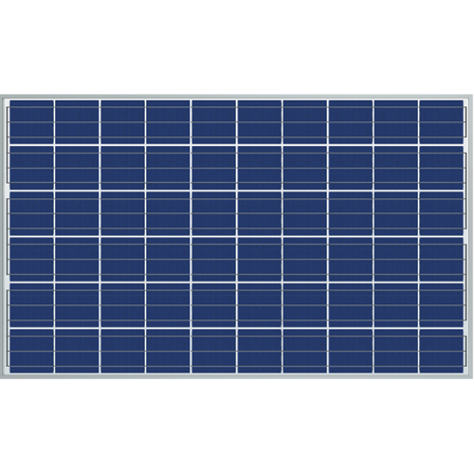




System Visual
PIR/Ambient Sensor
PIR Sensor
MCU
Cloud Database
App
Buck Converter and Inverter
Charge Controller and 12V Battery
Patio
Foyer

Slide 4
System Interface
Microcontroller Unit
Charge Controller
Inside Sensor
Outside Sensor
Solar Panel
Controllers and Sensors
Cloud Database
Control
12V Battery
Power Generation
App
Buck Converter
Converter/Inverter
Power
Data
Load & Inversion
Nick: Load & Inversion Atahan: Power Generation
Romi: MCU & Sensor Cedar: App & Database

Slide 5
Inverter and Buck converter
Team Member: Nick Miller
Accomplishments since the last presentation 24 Hours | Ongoing progress/problems and plans until the next presentation
Completed Subsystem Introduction project. Debugged Buck Converter schematic. Ordered components. Designed Inverter Circuit. Designed PCB for Buck Converters. Breadboarding circuits. | Validate/Order PCB’s. Continue Breadboard testing. Begin assembling PCB’s. Debugging Inverter Circuit.

Slide 6
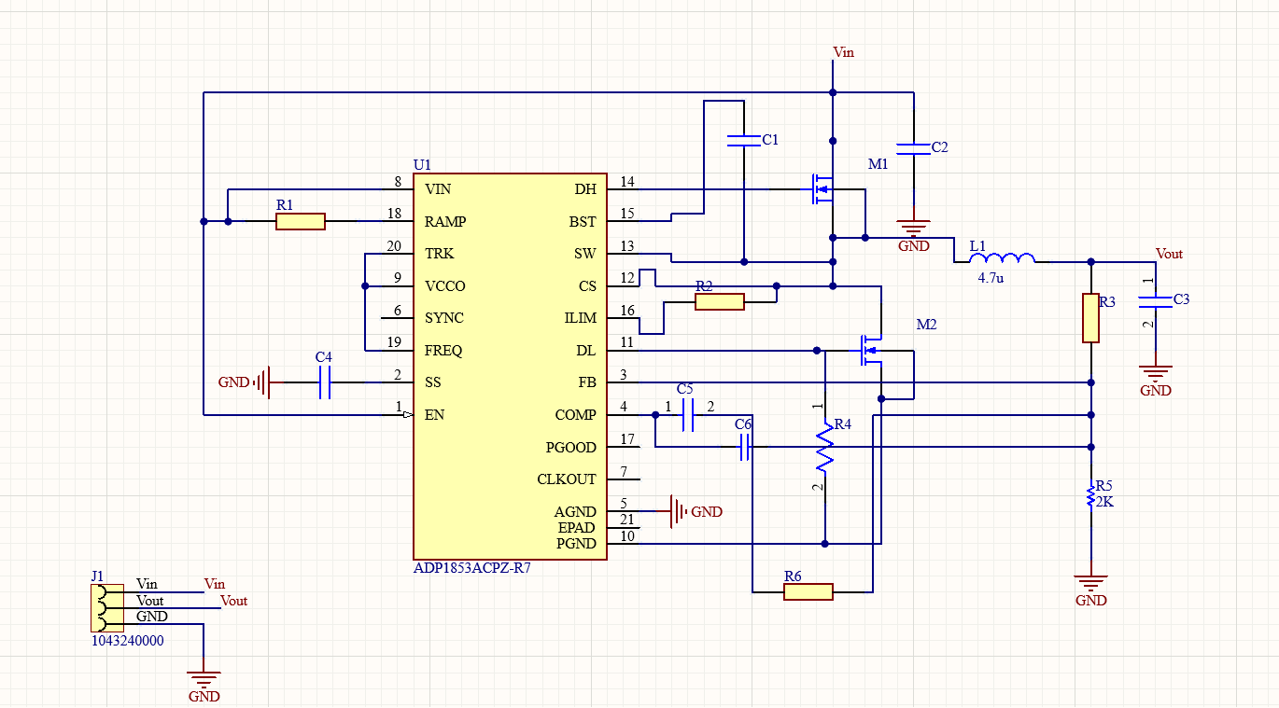
Buck Converter

Slide 7
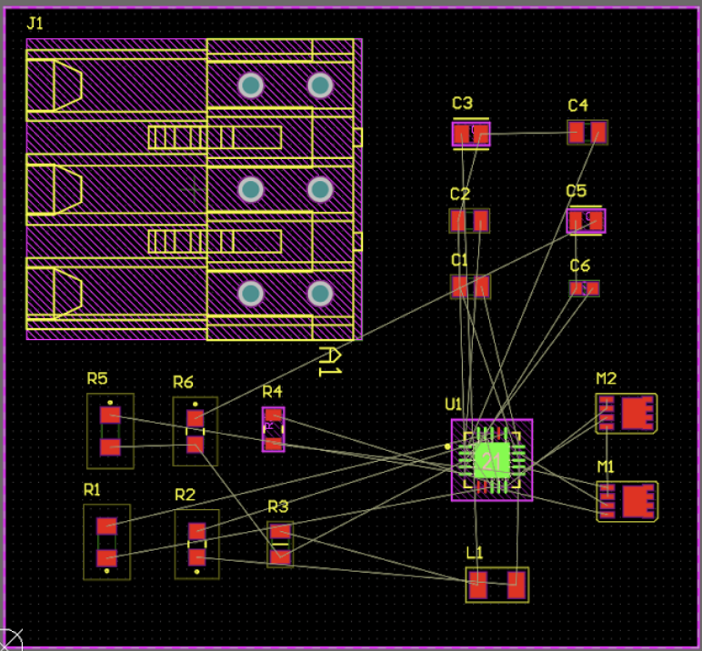
Buck Converter PCB

Slide 8
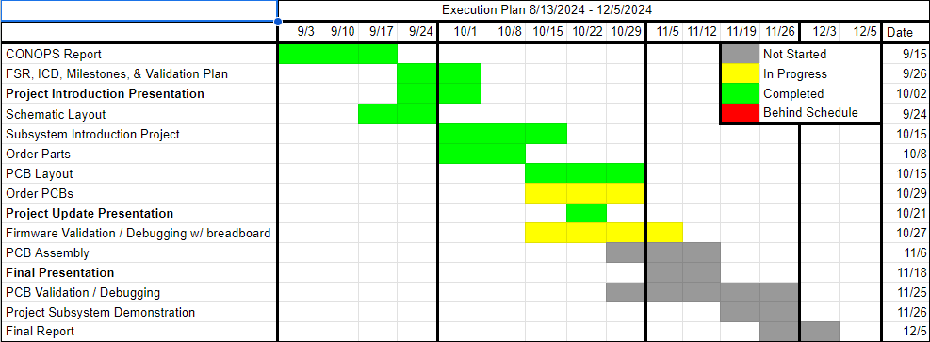
Subsystem Progress

Slide 9
Microcontroller and Sensor system
Team member: Romi Gilat
Accomplishments since the last presentation 30 hours | Ongoing progress/problems and plans until the next presentation
Finished introduction project PCB Schematic completed: Interior Sensor Exterior Sensor Microcontroller | PCB Layout: Exterior Sensor Interior Sensor MCU Order PCB Code ESP32 & PIC

Slide 10
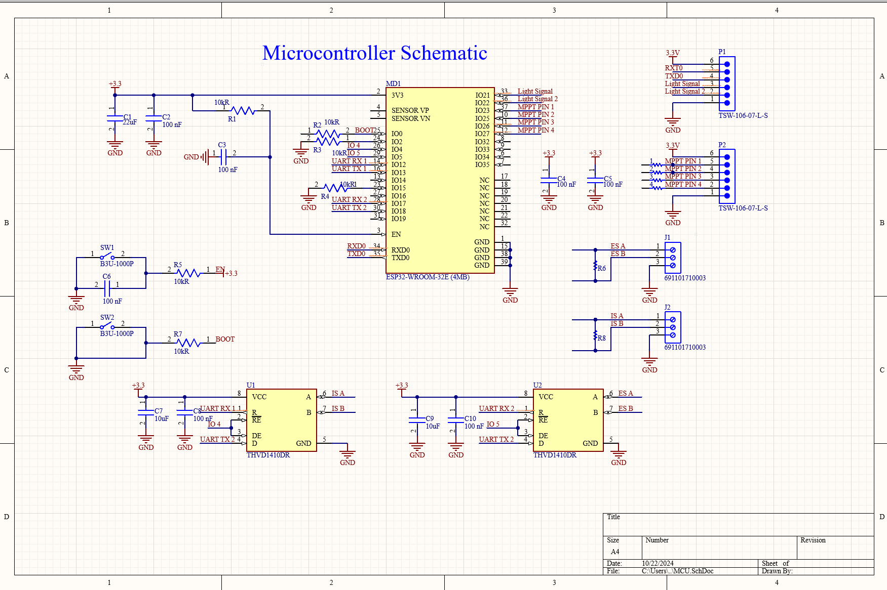
Microcontroller PCB schematic

Slide 11
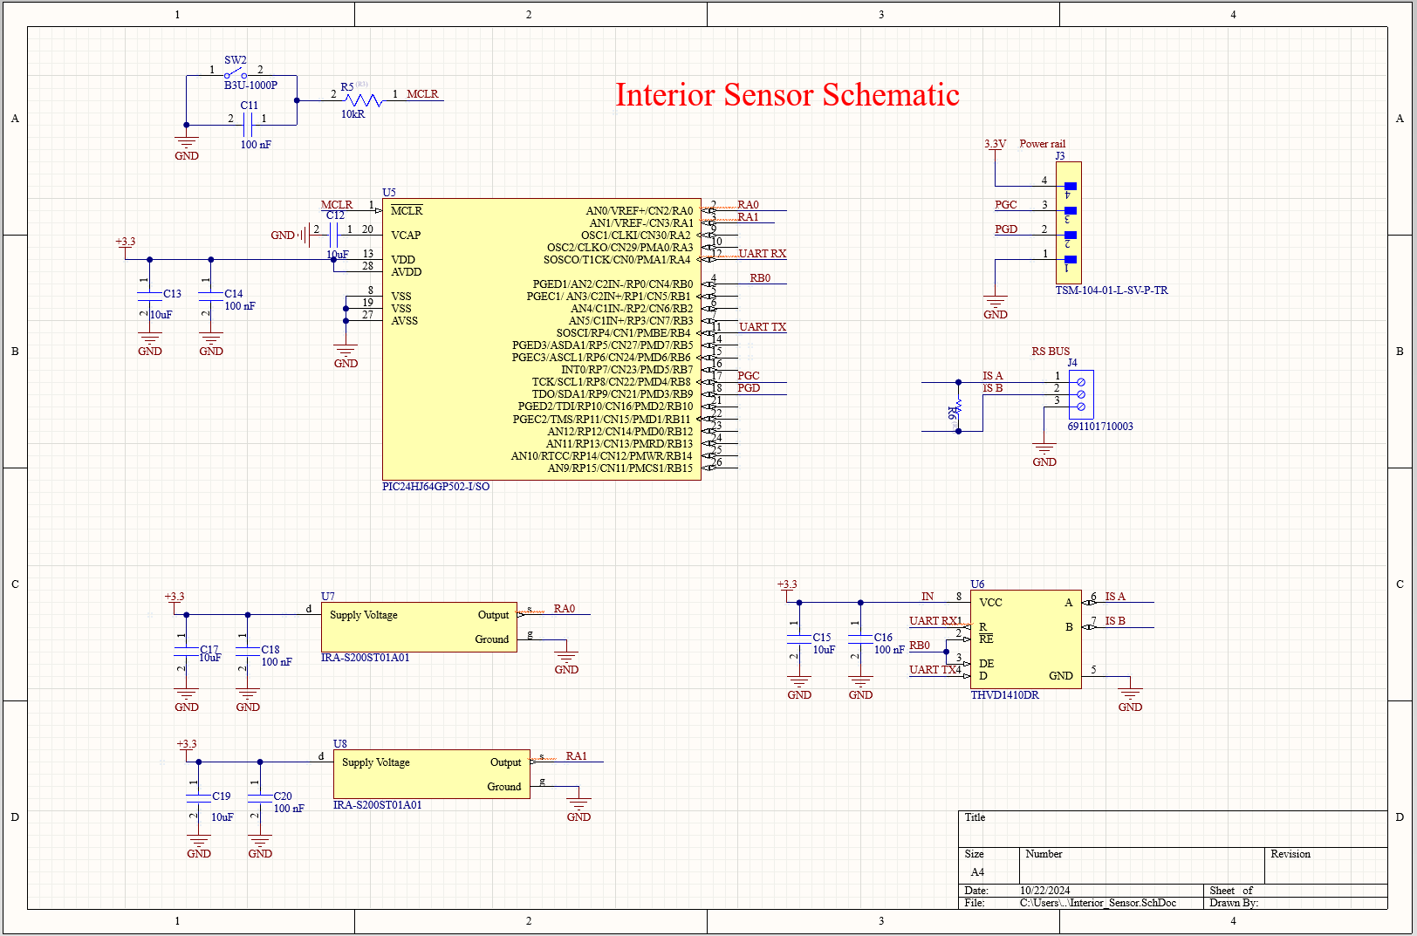
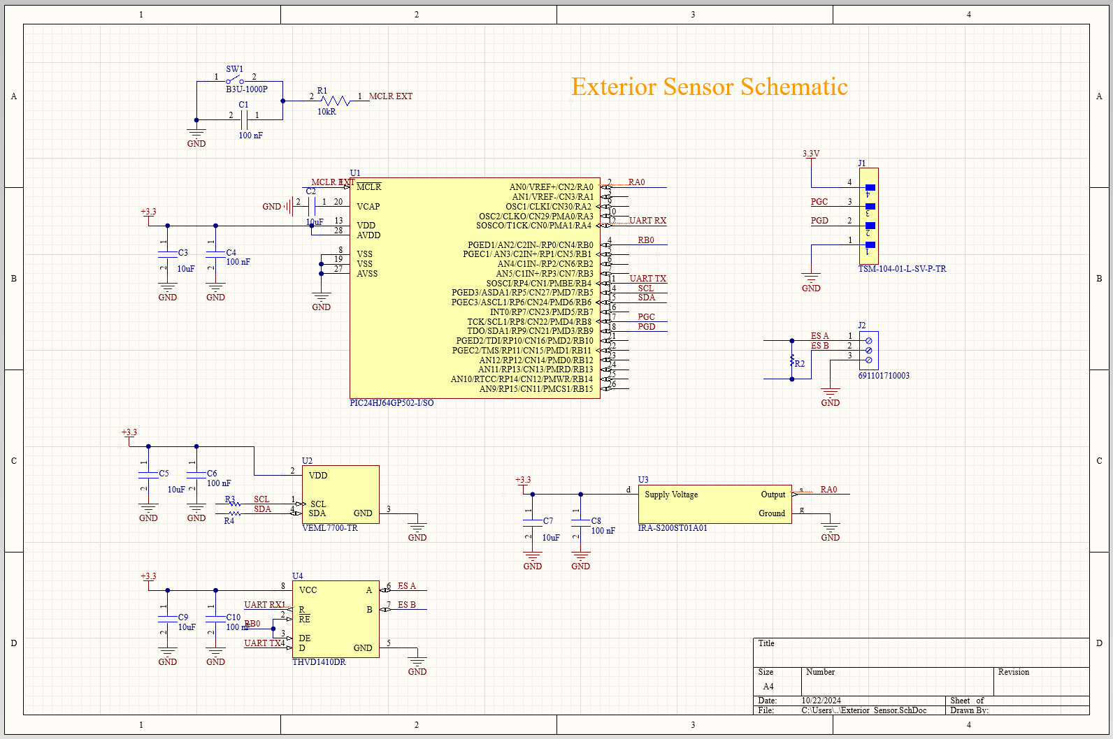
Exterior and Interior Sensor system
Notes:
romi

Slide 12
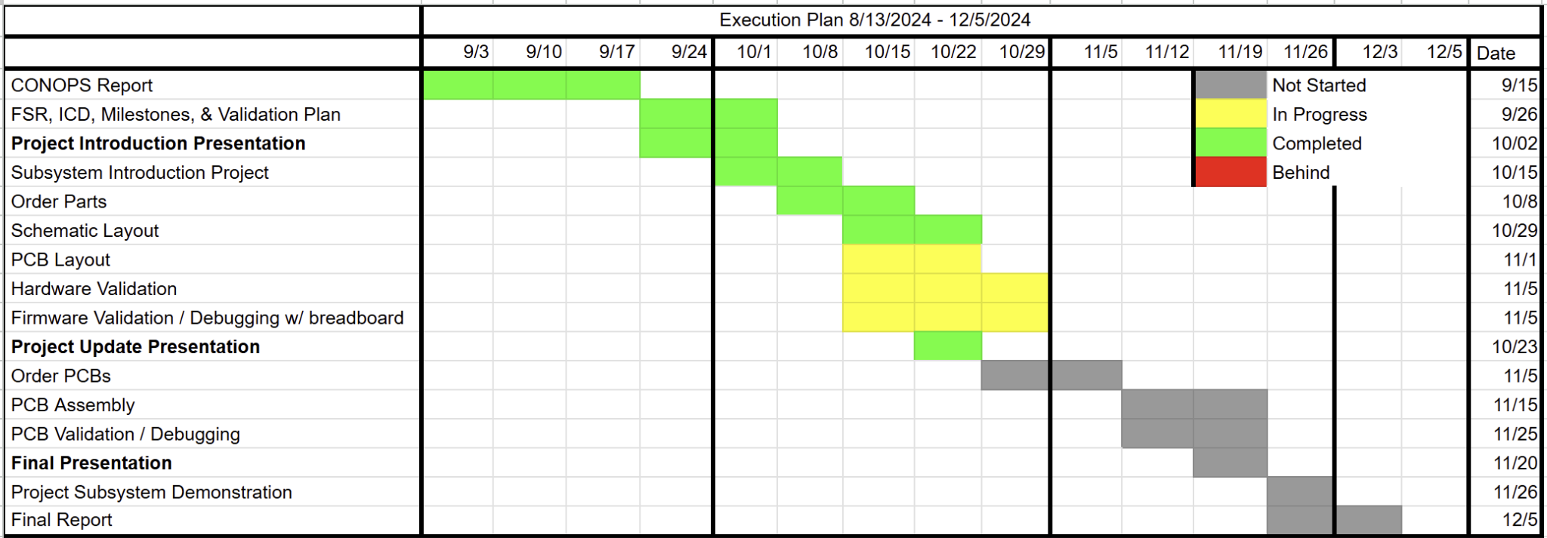
Subsystem Progress

Slide 13
Power Generation System
Team member: Atahan Bakanyildiz
Accomplishments since the last presentation <24> hrs | Ongoing progress/problems and plans until the next presentation
Finished Introductory Project Changed design to implement MPPT charging Completed schematic for charge controller Ordered Parts | PCB layout design Testing of components Debugging and testing using breadboarding Begin assembling PCB

Slide 14
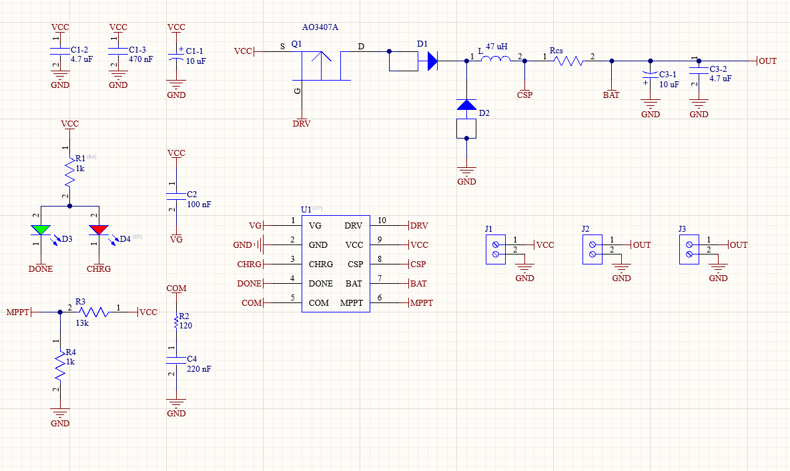
Charge Controller PCB Schematic

Slide 15
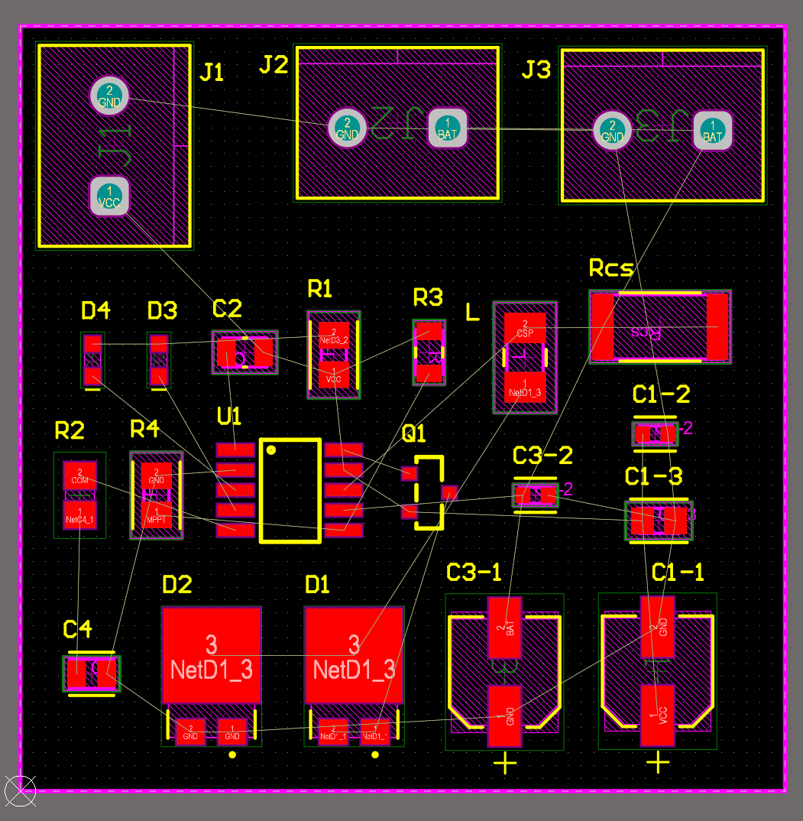
Charge Controller PCB Layout Progress

Slide 16
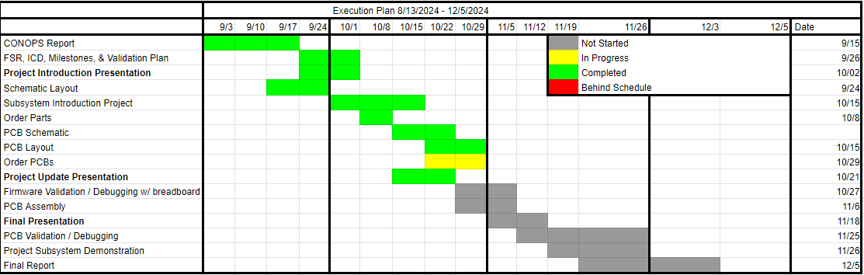
Subsystem Progress

Slide 17
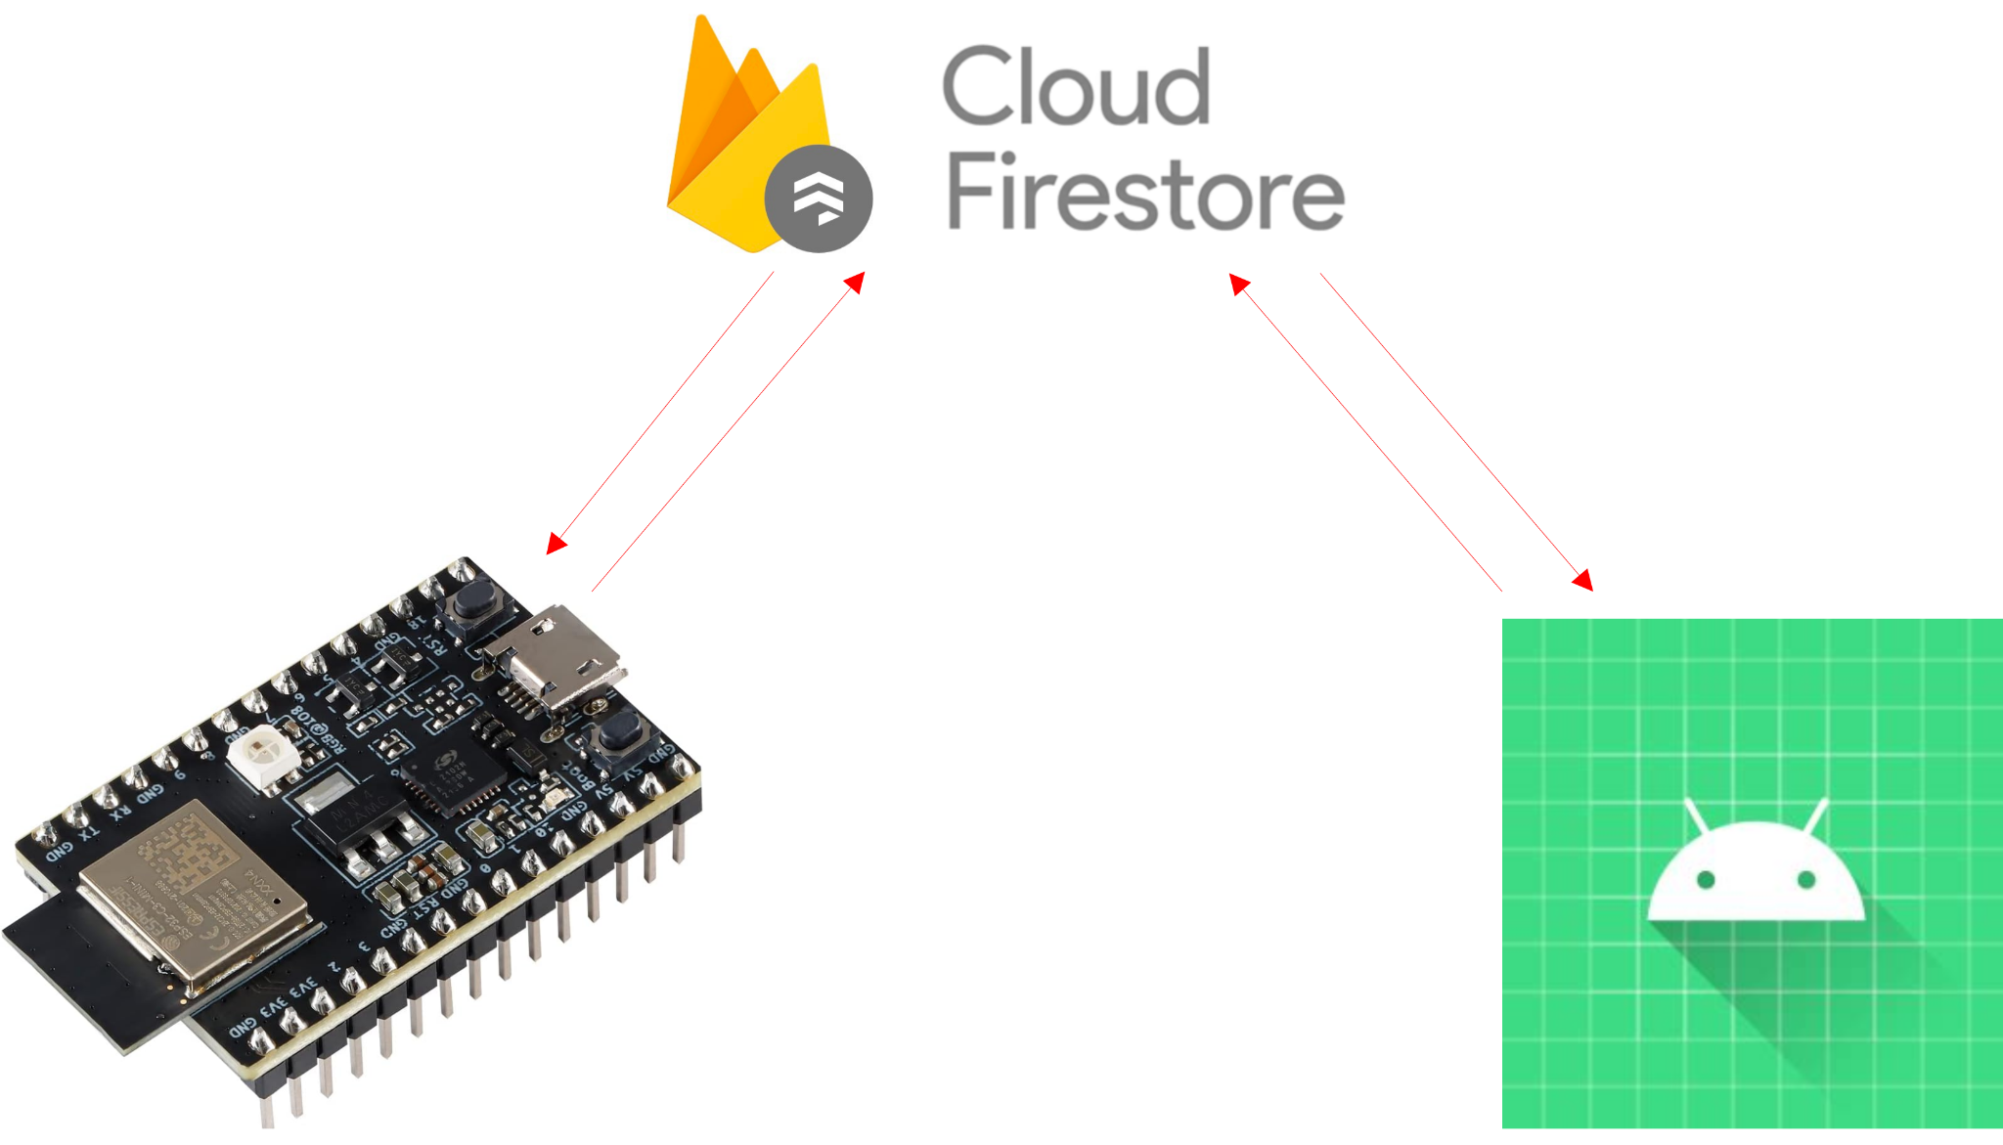
App and Database progress
Accomplishments since last presentation Total time spent: 12 hrs | Ongoing progress, problems and plans until next presentation
Subsystem Introduction Project completed Android App and Firebase Cloud Firestore database connected App can display data from the Firebase online database | App to receive updates from Firebase in real time Change values on Firebase from the app Database to be equipped to record battery voltage history App to display voltage graph of past 30s Error logging from Firebase, which will in turn be relayed from the Solar Lighting System

Slide 18
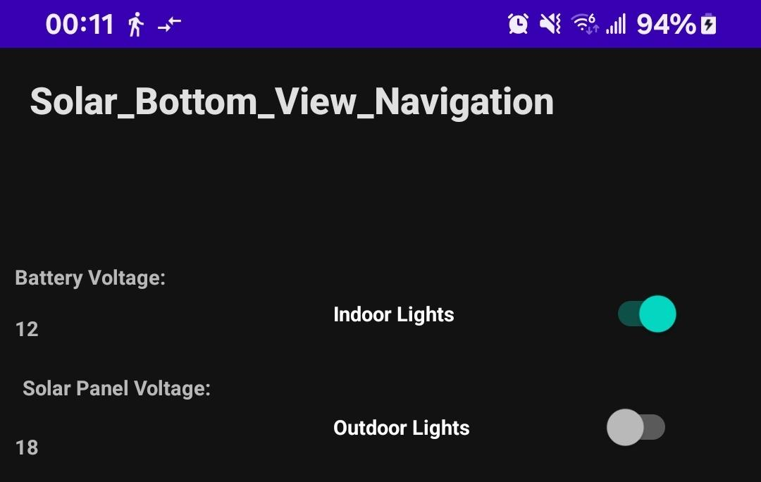
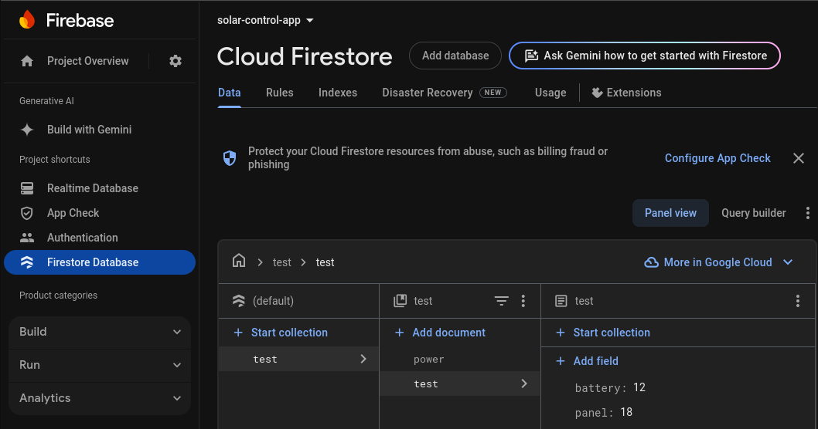

Slide 19
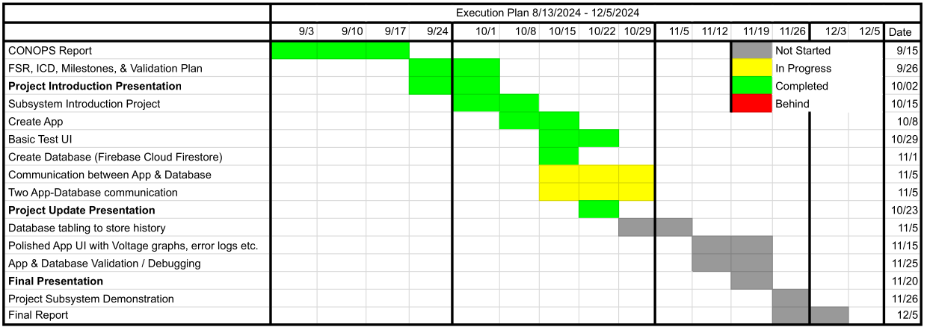
Subsystem Progress

Slide 20
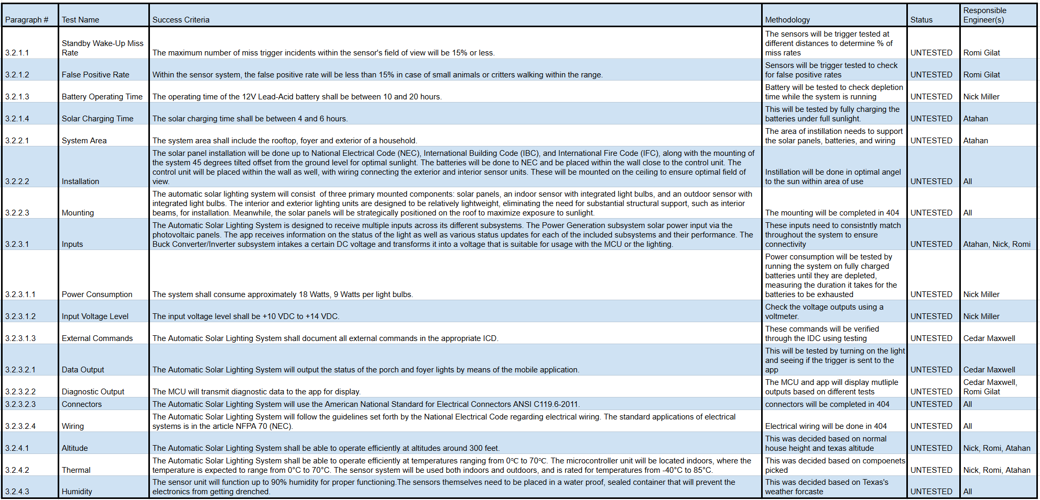
Verification Schedule

